Slide 1
Professional Practice of Education Assistants
Panel Presentation

Slide 2

Introductions
Topic:
What is the role and responsibilities of an Education Assistant?

Slide 3
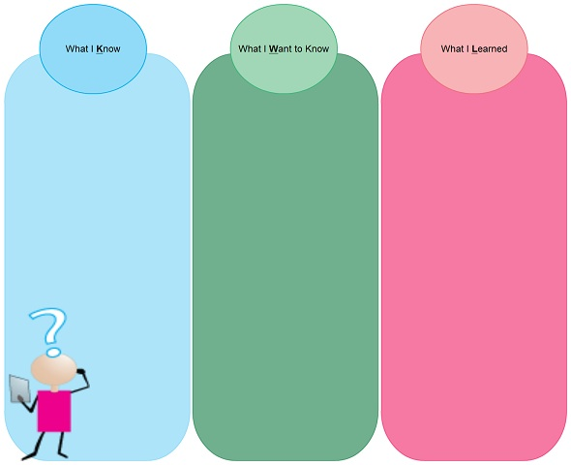

Activity: KWL
Review own chart.
Add / revise - use a different colour to show changes.
Put points up on chart paper
If your point is already up, put a check mark beside it

